Slide 1

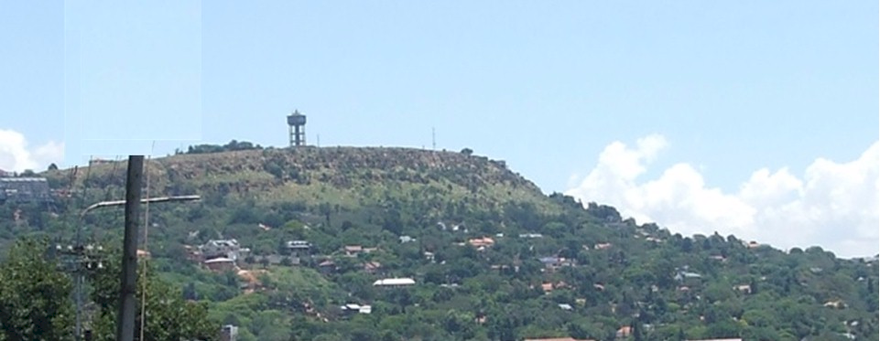

Turning history on its head
Massive evidence of a global flood
What does it all mean?
End Time Issue Ministries
December 2010
Dr James A Robertson PrEng

Slide 2
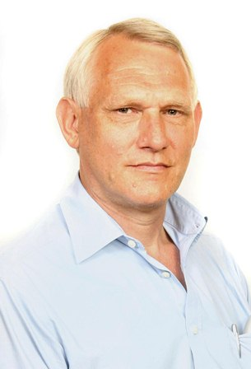
Caution – a special request
There is a very large amount of material in this presentation that is controversial
Please focus on what you can agree with and park those things you cannot agree with for future consideration or discard them
I truly believe there is much of value in what follows and urge you to focus on what is valuable to you ☺

Slide 3

Acknowledgement
Jonathan Gray
The information and thinking that triggered the understanding of the formation of the earths crust discussed in this presentation came to me from material published by Jonathan Gray www.beforeus.com and www.archaeologyanswers.com
You can contact Jonathan at:
Email : info@archaeologyanswers.com
Post : Surprising Discoveries, PO Box 785, Thames, 3540, New Zealand
This material forms the foundation on which my current understanding has been built
This information has been supplemented from my own knowledge and experience and diverse other sources

Slide 4
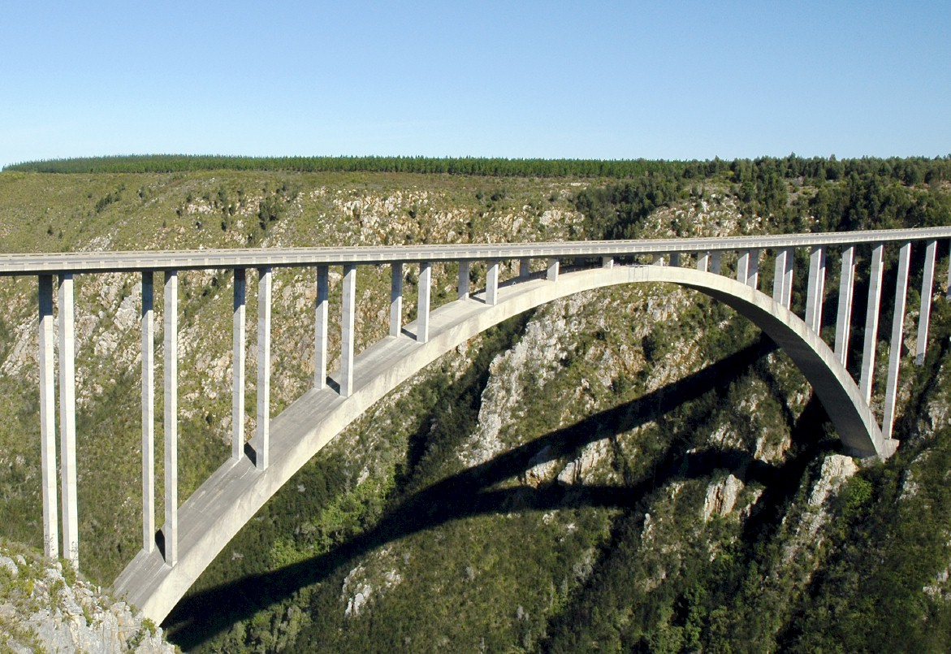
Historical theories versus bridges
Notes:
In considering what i have learned as an engineer with considerable experience of the practical application of information technology i eventually realized about ten years ago that
ENGINEERS DO NOT DESIGN BRIDGES TO STAND UP – click

Slide 5
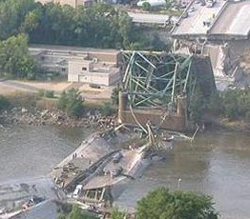
Engineers do NOT design bridges to stand up
Notes:
Who remembers this bridge collapse in Minneapolis in the middle of 2007? Within minutes it was front page news around the world – we do NOT expect bridges to fall down – if we did there would not have been anyone on that bridge that day!

Slide 6
Engineers design bridges NOT to fall down
Notes:
There is a fundamental difference in approach when one designs a bridge NOT TO FALL DOWN
Contrast this with the history paradigm of failed theories and theories that do not stand up to the test of time or engineering reality
In this presentation i am going to challenge a number of theories regarding the age of the earth and the history of the formation of our current geology and topography, i am NOT going to challenge verifiable facts, i AM going to challenge theories that fall down when subject to close scrutiny

Slide 7



What is NOT an engineering approach?
Notes:
What is not an engineering approach? – Dramatically walk to chair – video clip extract from Dorsa Padideh video – did this ever happen to you? –
WHEN SLEEPING
when i was a child i used to dream that i would stand on a chair and flap my arms and fly around the room --i have to say that that is NOT an engineering approach – as much as i may be convinced i can fly i have to say to you that were i to stand on top of a skyscraper and flap my arms and jump i would hit the ground at great speed and almost certainly die – that is NOT an engineering approach and yet many seem to think they can use software to do things magically – many are hypnotized and mesmerized by IT – are you? CLICK for rabbit out of the hat
We can imagine anything we like about history, whether there was a flood or primevil soup or whatever – what is the truth, there is ONLY one reality about how the surface of this planet came to look the way it does
Find quote on web regarding the formation of the current surface, possibly some sort of diagram

Slide 8



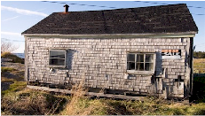
What is strategy?
Die fast
Thrive
Tactics – Doing things right ➔
Die slowly
Survive
Strategy – Doing the right things ➔
Professor Malcolm McDonald
Notes:
Strategy – a key focus of my management consulting business – doing the right things well – if we are to have a theory about the history of the earth or the history of mankind, it must be strategically valid and valuable and fit all the facts

Slide 9
What is strategy?
The right things done right
The essence of why an organization exists and how it thrives
The essence of why a theory exists and how it supports humanity to thrive
Notes:
What is the essence of why mankind and the earth exist and how it thrives?
What do we need to know about the reasons for our existence and how will we know that we are thriving?

Slide 10
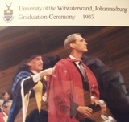
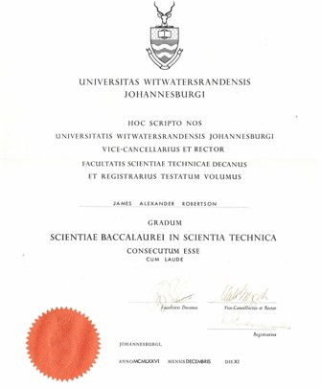

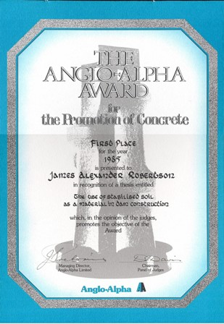
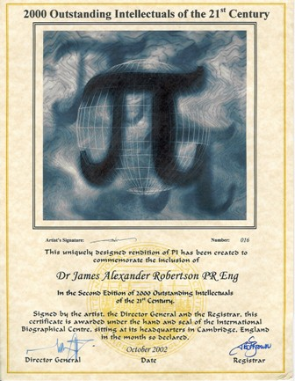
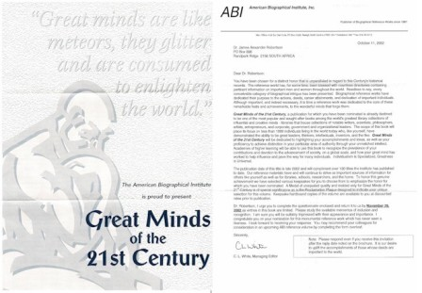
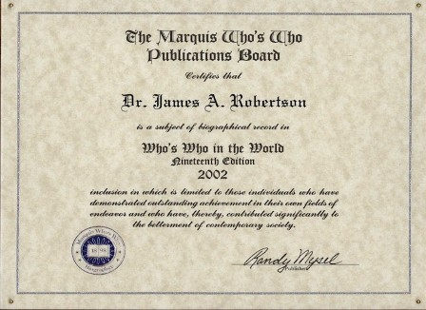
Credentials
Academic and Engineering
End High School 1971 Grade 12 -- distinctions in Maths, Science and Biology
Top Biology student in South Africa National Youth Science Week -- 1971
BSc Engineering (Civil) Cum Laude -- 1976
Doctor of Philosophy Civil Engineering -- 1985
Anglo Alpha award for the Promotion
of Concrete for PhD
2000 Outstanding Intellectuals
Great Minds of the 21st Century
Who’s Who in the World five times
Other accolades
Notes:
JAR nice photo in corner of each credentials slide
Graduation photo in middle of slide with degree certificates and memberships, etc
Matric, BSc, high grades throughout, Science, focus on understanding
Engineering, analysis, IT, economics, engineering principles – images of degrees, Anglo Alpha, PhD graduation, SAICE, SAIMM – all on one page as a collage fade in progressively

Slide 11

Mathematics and Law
Reductio ad absurdem
Reduce to the absurd
Google 182,000 occurences ➔ widely recognized approach
Reduce to the absurd or proof by contradiction
Fundamental logical, mathematical and legal principle
Reductio ad absurdum (Latin: "reduction to the absurd") is a form of argument in which a proposition is disproven by following its implications to a logical but absurd consequence.^{[1]}
A particular kind of reductio ad absurdum, in its strictest sense, is proof by contradiction (also called indirect proof) where an assumption is proven false because it leads to a contradiction
In logic, proof by contradiction is a form of proof that establishes the truth or validity of a proposition by showing that the proposition being false would imply a contradiction.
From Wikipedia
Notes:
Look for quotes etc that were used in the evolution book

Slide 12
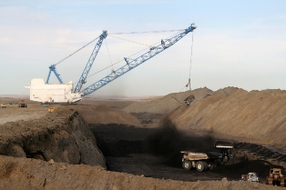
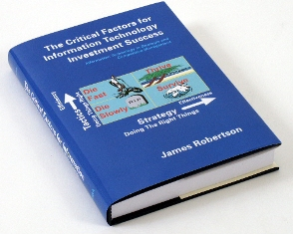
Credentials
Employment
Fathers investment consultancy specializing in South African Gold Shares, developed economic models of all South African Gold Mines, fundamental understanding of the economics and mechanics of Gold Mining
International Mining and Geotechnical engineering consultancy, mine design, slope stability, developed Dragline Hazard Management approach, mines throughout Southern Africa
Own management consultancy
– the strategic application
of Information Technology

Slide 13


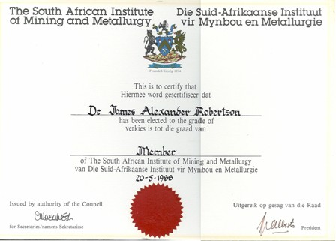
Credentials
Professional
Member of the South African Institution of Civil Engineering
Member of the South African Institute of Mining and Metallurgy
Member of the Society for Professional Engineers
Registered as a Professional Engineer with the
Engineering Council of South Africa
Professional Member of the
Professional Speakers Association of
Southern Africa

Slide 14
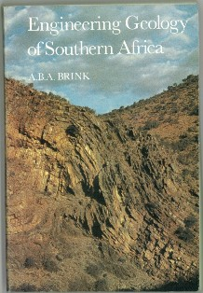
Engineering geotechnics and geology
Geology a childhood interest that remains to this day
Fathers best friend a mining engineer
Down diverse types of mine
Geology at University with particular emphasis on the
Witwatersrand
PhD in Materials Science and Geotechnics – Cement Stabilized Soils for the Construction of large dams – manufacture of rock-like material through the application of pressure and cement
Consulting with regard to Mining Geotechnics at diverse mines around Southern Africa
Ongoing interest in Geology and Topography as I travel around
Also a study of ceramics
Notes:
Geology interest from childhood, exposure to different rock types, geology club, down mines at an early age, lived surrounded by the mining environment, collecting rocks, fathers best friend was a Mining Engineer, .
Geology at University – photo of Tony Brinks book
PhD in cement stabilized soils for dam construction – manufacturing rock and testing rock – photo of Thesis, images from thesis, samples, rock shear machine, triaxial testing, graph of strength vs cement, leaching summary, things that support this presentation
Rock is created by pressure
Pottery and ceramics – wife interested, i studied – pottery kiln
Hard rock is created by heat and pressure
Travelled widely, Europe, Africa, USA, etc

Slide 15
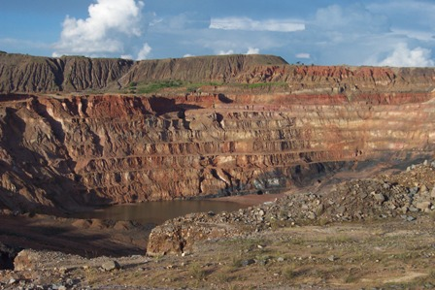
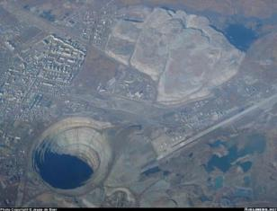

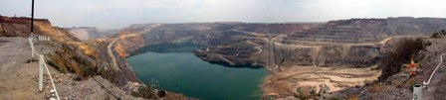
Mining experience
Gold and other mines as a visitor and student
Rietspruit and Kriel Collieries Dragline Hazard management plans horizontally bedded sedimentary rocks
Gecamines KOV Open Pit in Democratic Republic of the Congo, contorted sedimentary rocks, Copper
Nchanga Open Pit in Zambia, contorted
sedimentary rocks, Copper
Finsch Diamond Mine, diamond pipe
General interest in Mining
Notes:
Mining engineering, Rietspruit and Kriel – large horizontal sedimentary deposits, Nchanga and KOV contorted sedimentary deposits, iron ore body modelling, rock slope stability South of Johannesburg – photo’s of all

Slide 16
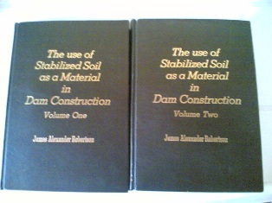
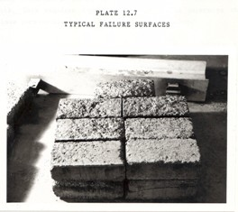
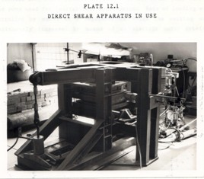
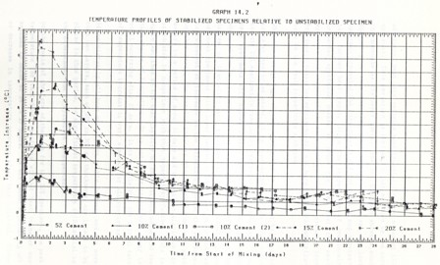
PhD research
Cement stabilized soils for dam construction
Compressed and cemented soils
Weak rock
Compressive strength tests
Shear strength tests
Heat of hydration tests
Permeability tests
Leaching tests
etc
Notes:
Geology interest from childhood, exposure to different rock types, geology club, down mines at an early age, lived surrounded by the mining environment, collecting rocks, fathers best friend was a Mining Engineer, .
Geology at University – photo of Tony Brinks book
PhD in cement stabilized soils for dam construction – manufacturing rock and testing rock – photo of Thesis, images from thesis, samples, rock shear machine, triaxial testing, graph of strength vs cement, leaching summary, things that support this presentation
Rock is created by pressure
Pottery and ceramics – wife interested, i studied – pottery kiln
Hard rock is created by heat and pressure
Travelled widely, Europe, Africa, USA, etc

Slide 17
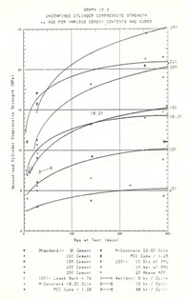
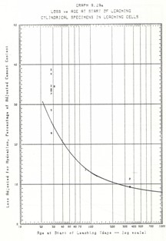
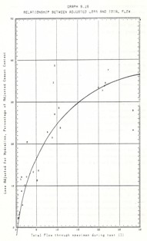
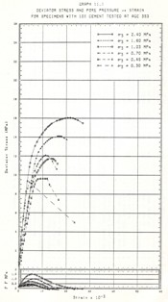
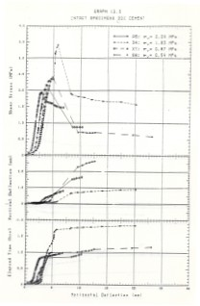
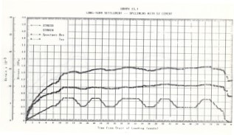
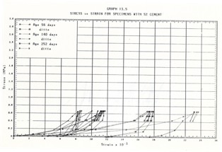

PhD research
Test results are ALL non-linear (exponential)

Slide 18
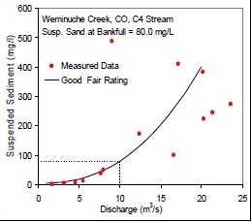

Exponential characteristics
Most strength, decay and other characteristics are exponential
Change follows an exponential trajectory
Bed load and sediment load in water follow an exponential trajectory
Your car follows an exponential trajectory when you change direction
Extrapolation from the tail end of an
exponential distribution, especially on the
basis of linear assumptions is highly
inadvisable
versus

Slide 19

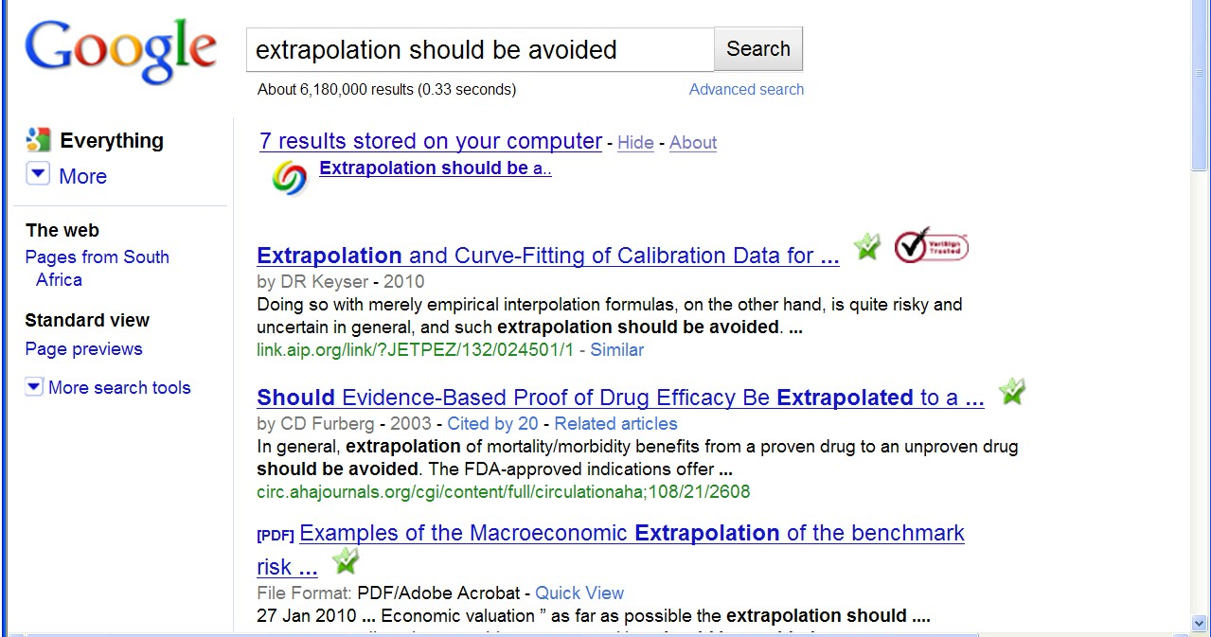
“Extrapolation should be avoided”
A fundamental engineering principle
Only limited increments outside known ranges
Fundamental principle of engineering analysis and design
Google search for words ‘extrapolation should be avoided’ 6,180,000 pages with the words on the same page
965 pages with the exact phrase “extrapolation should be avoided”
Any theory that relies on extrapolation MUST be suspect
All theories relating to the origin of the earth, the age of the earth, the age of geological formations, etc are THEORIES
Examine such theories critically and do NOT suspend your intellect
Notes:
Engineering principle, do NOT extrapolate – engineering characteristics, triaxial and shear tests from PhD – linear portion and then non-linear, erosion bed load – images from article off the web, other graphs that illustrate partly linear and partly non-linear characteristics
If you do extrapolate do so in small increments, test thoroughly in the laboratory and apply a belt and braces approach
It is contrary to fundamental engineering principles to extrapolate from a few centuries or even a few thousand years backwards by thousands, let alone millions let alone billions of years – like a flea at the end of an elephants tail trying to describe its environment
Ant on a railway line taking a view of where Cape Town is or any city 1,000 km away and the route the track follows and ...
Extrapolation – note re Google 1,440 occurences of the quote “extrapolation should be avoided” and 6,180,000 results for extrapolation should be avoided not in quotes, ie all the key words occur on 6 million web pages
Time line to scale cascading magnifying glasses scale of 1 in 1 million and 1 in 1 billion
Railway line to Cape Town to scale of 100 million years relative to recorded human history, cannot take a view of where the line goes when it leaves the station – image of Joburg Station – Google Earth
We must be practical and accept that we cannot extrapolate much beyond the point that we can see backwards in time and we must place heavy reliance on those who lived before us – if there is a book that says there was a global flood about 4,500 years ago and this is corroborated by other books and traditions then we need to give credence to this and not discount it summarily
Dating by radio-carbon or other techniques that assume constant state is fundamentally flawed, if there was a massive event with radioactive impacts some time in the recent past then all theories of dating become entirely invalid
Ask the critical questions and do NOT be fobbed off with academic arguments that make you feel stupid
Do not be fobbed off by “i can show you hundreds / thousands of academics and professionals who will agree with me”
Or “this is waco” as i was told by a good friend some time ago
You are NOT stupid so the explanation for anything should be capable of being intellectually evaluated, understood and accepted or discarded
If you prefix your responce to anything in this presentation with “i do not understand ... (geology, astronomy, geotechnics, physics, etc)” then you are abdicating your intellect, I challenge you to think critically about all that i have to say and show you

Slide 20


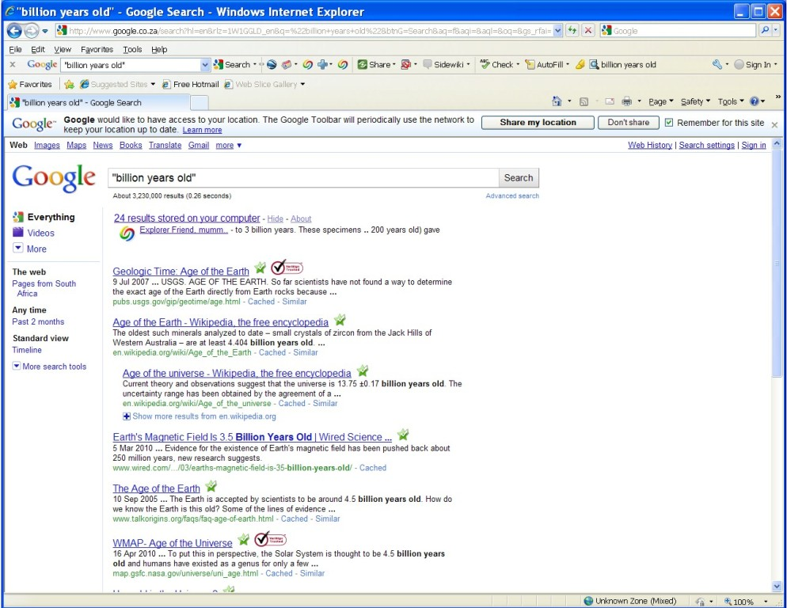
A reality check
Historical theory
Google 7,440,000 entries “million years old”
Bone eating worms “30 million years old”
Laughter “16 million years old”
Google 3,230,000 entries “billion years old”
“The generally accepted age for the Earth and the rest of the solar system is about 4.55 billion years (plus or minus about 1%)”
How reliable are these figures?
What if there was some radical change we are not aware of?
Notes:
City skyline and rabbit out the hat from earlier slide
Must be able to stand up to the same level of scrutiny as a bridge, must not fall down when tested against what we can see all around us
Quote regarding the formation of current topography – millions or billions of years, gradual, eroded
There is much of Geology, Archaeology, Palaeontology, etc that deals with facts but there are some assumptions that i plan to challenge today

Slide 21


Extrapolation over millions or billions of years is invalid
Like an ant on a railway track claiming to know where the train has come from and how long it took and the route it followed
versus
Notes:
Engineering principle, do NOT extrapolate – engineering characteristics, triaxial and shear tests from PhD – linear portion and then non-linear, erosion bed load – images from article off the web, other graphs that illustrate partly linear and partly non-linear characteristics
If you do extrapolate do so in small increments, test thoroughly in the laboratory and apply a belt and braces approach
It is contrary to fundamental engineering principles to extrapolate from a few centuries or even a few thousand years backwards by thousands, let alone millions let alone billions of years – like a flea at the end of an elephants tail trying to describe its environment
Ant on a railway line taking a view of where Cape Town is or any city 1,000 km away and the route the track follows and ...
Extrapolation – note re Google 1,440 occurences of the quote “extrapolation should be avoided” and 6,180,000 results for extrapolation should be avoided not in quotes, ie all the key words occur on 6 million web pages
Time line to scale cascading magnifying glasses scale of 1 in 1 million and 1 in 1 billion
Railway line to Cape Town to scale of 100 million years relative to recorded human history, cannot take a view of where the line goes when it leaves the station – image of Joburg Station – Google Earth
We must be practical and accept that we cannot extrapolate much beyond the point that we can see backwards in time and we must place heavy reliance on those who lived before us – if there is a book that says there was a global flood about 4,500 years ago and this is corroborated by other books and traditions then we need to give credence to this and not discount it summarily
Dating by radio-carbon or other techniques that assume constant state is fundamentally flawed, if there was a massive event with radioactive impacts some time in the recent past then all theories of dating become entirely invalid
Ask the critical questions and do NOT be fobbed off with academic arguments that make you feel stupid
Do not be fobbed off by “i can show you hundreds / thousands of academics and professionals who will agree with me”
Or “this is waco” as i was told by a good friend some time ago
You are NOT stupid so the explanation for anything should be capable of being intellectually evaluated, understood and accepted or discarded
If you prefix your responce to anything in this presentation with “i do not understand ... (geology, astronomy, geotechnics, physics, etc)” then you are abdicating your intellect, I challenge you to think critically about all that i have to say and show you

Slide 22
A reality check
Historical theory
Notes:
What is not an engineering approach? – Dramatically walk to chair – video clip extract from Dorsa Padideh video – did this ever happen to you? –
WHEN SLEEPING
when i was a child i used to dream that i would stand on a chair and flap my arms and fly around the room --i have to say that that is NOT an engineering approach – as much as i may be convinced i can fly i have to say to you that were i to stand on top of a skyscraper and flap my arms and jump i would hit the ground at great speed and almost certainly die – that is NOT an engineering approach and yet many seem to think they can use software to do things magically – many are hypnotized and mesmerized by IT – are you? CLICK for rabbit out of the hat
We can imagine anything we like about history, whether there was a flood or primevil soup or whatever – what is the truth, there is ONLY one reality about how the surface of this planet came to look the way it does
Find quote on web regarding the formation of the current surface, possibly some sort of diagram

Slide 23
What if ... ?
Historical time
What if there was a massive catastrophic event that totally reshaped the surface of the earth not that long ago
Would the ant see anything different?
Would aging calculations be turned upside down?
Could ancient historical writings be accurate?
Notes:
Engineering principle, do NOT extrapolate – engineering characteristics, triaxial and shear tests from PhD – linear portion and then non-linear, erosion bed load – images from article off the web, other graphs that illustrate partly linear and partly non-linear characteristics
If you do extrapolate do so in small increments, test thoroughly in the laboratory and apply a belt and braces approach
It is contrary to fundamental engineering principles to extrapolate from a few centuries or even a few thousand years backwards by thousands, let alone millions let alone billions of years – like a flea at the end of an elephants tail trying to describe its environment
Ant on a railway line taking a view of where Cape Town is or any city 1,000 km away and the route the track follows and ...
Extrapolation – note re Google 1,440 occurences of the quote “extrapolation should be avoided” and 6,180,000 results for extrapolation should be avoided not in quotes, ie all the key words occur on 6 million web pages
Time line to scale cascading magnifying glasses scale of 1 in 1 million and 1 in 1 billion
Railway line to Cape Town to scale of 100 million years relative to recorded human history, cannot take a view of where the line goes when it leaves the station – image of Joburg Station – Google Earth
We must be practical and accept that we cannot extrapolate much beyond the point that we can see backwards in time and we must place heavy reliance on those who lived before us – if there is a book that says there was a global flood about 4,500 years ago and this is corroborated by other books and traditions then we need to give credence to this and not discount it summarily
Dating by radio-carbon or other techniques that assume constant state is fundamentally flawed, if there was a massive event with radioactive impacts some time in the recent past then all theories of dating become entirely invalid
Ask the critical questions and do NOT be fobbed off with academic arguments that make you feel stupid
Do not be fobbed off by “i can show you hundreds / thousands of academics and professionals who will agree with me”
Or “this is waco” as i was told by a good friend some time ago
You are NOT stupid so the explanation for anything should be capable of being intellectually evaluated, understood and accepted or discarded
If you prefix your responce to anything in this presentation with “i do not understand ... (geology, astronomy, geotechnics, physics, etc)” then you are abdicating your intellect, I challenge you to think critically about all that i have to say and show you

Slide 24



Religious and spiritual
Church of England (Anglican as a child through early 20’s)
Disillusioned with hypocrisy and bad attitude, walked away
Church teaching did not fit, not practical, illogical, inconsistent, “believe the book” {Bible} but ignored the book, etc
Dramatic encounter with the Almighty when on point of death
Deep evidentially based conviction He exists and is real
Engineering approach, lots of questions, doctrine that stands and does not fall, looking for truth, lot of answers -- many the church do not like but it works, read the book {bible} “Old” more than 20 times, “New” more than 50 times -- numerous translations
Know the book {bible} better than most
“Faith and belief must FIT THE FACTS”
Notes:
Spiritual, disenchanted, near death, dramatic encounter with the creator, sceptical, critical engineering approach to spiritual and religious issues
Use a photo from NASA of a mass of stars plus some electron microscope images and a few others that evidence the diversity of creation
Do NOT spend much time on this
An engineering approach to religion and to the book called the bible (Greek Biblios means book – check this)

Slide 25
Fundamental laws of physics
Force = mass multiplied by acceleration
Any change in state, any movement relative to an apparently static position requires an external force
Disruption of the surface of the earth requires an EXTERNAL force, it cannot happen within a state of equilibrium on the planet
All evidence of dramatic change is also evidence of dramatic forces being applied
Evidence of a vertical up or down thrust of the surface of the earth is evidence of massive forces being applied
The nature of such a displacement is such that the force is almost certainly external
Notes:
Look for formulae
Newton?? Force = mass x acceleration – huge forces to move large rocks
Exponential relationship between water velocity and carrying capacity
Strength of rock is NOT linear
Strength increases with increase in density – graph from my thesis

Slide 26
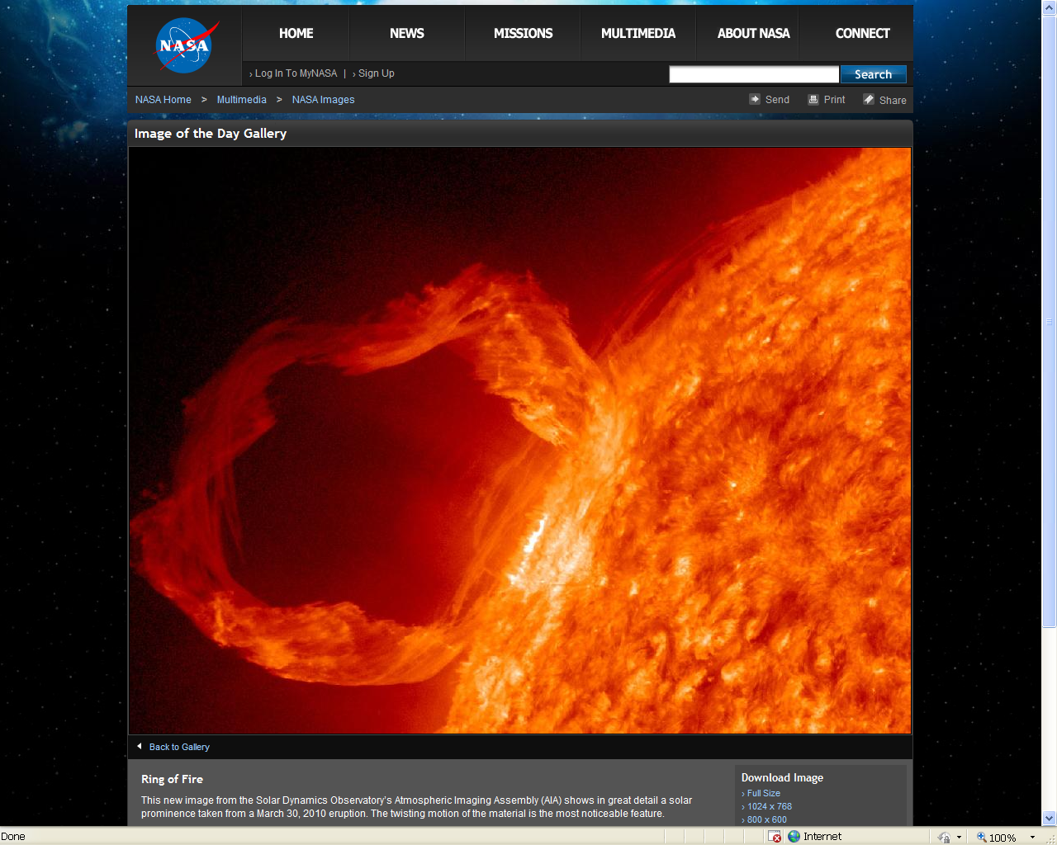
We live in an unstable Universe
Solar prominence -- NASA – Solar Dynamics Observatory
Notes:
NASA images of star formation, black holes, Kuyper belt, ice asteroid, etc massive high speed change and flux, effectively instability
Large crater on Mars ?1,400 miles? NASA
Evidences that we CANNOT assume constancy for millions of years, probably not even for thousands of years – star moving at 250,000 miles per hour – 2 hours to the moon, can appear seemingly from nowhere and hit the earth in a few years especially if it is smaller and we are not watching for it
What happens if a chunk of ice like the artists impression hits the earths atmosphere and melts, massive flooding IS possible

Slide 27
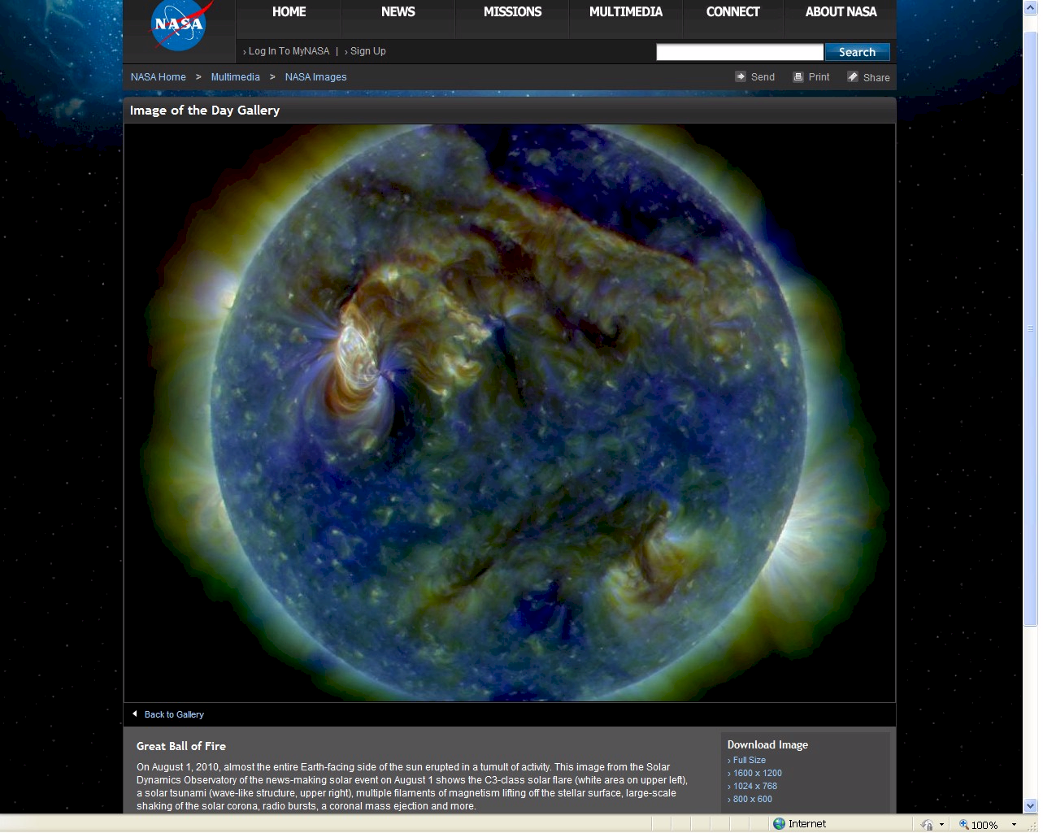
We live in an unstable Universe
NASA – intense activity on the surface of our sun 1 August 2010

Slide 28
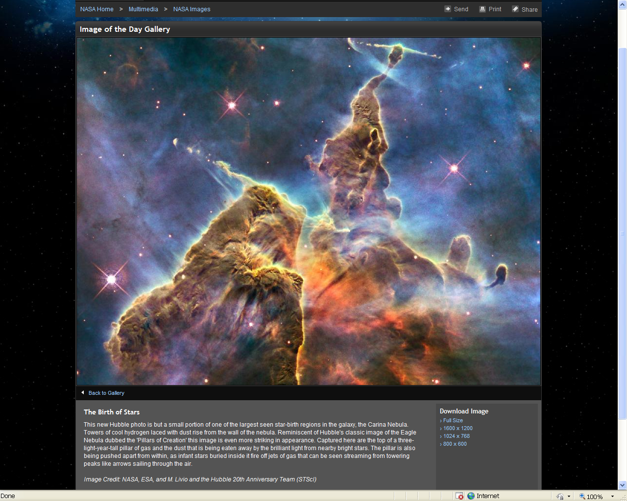
We live in an unstable Universe
NASA – Hubble -- Birth of Stars three light year high pillar of gas

Slide 29
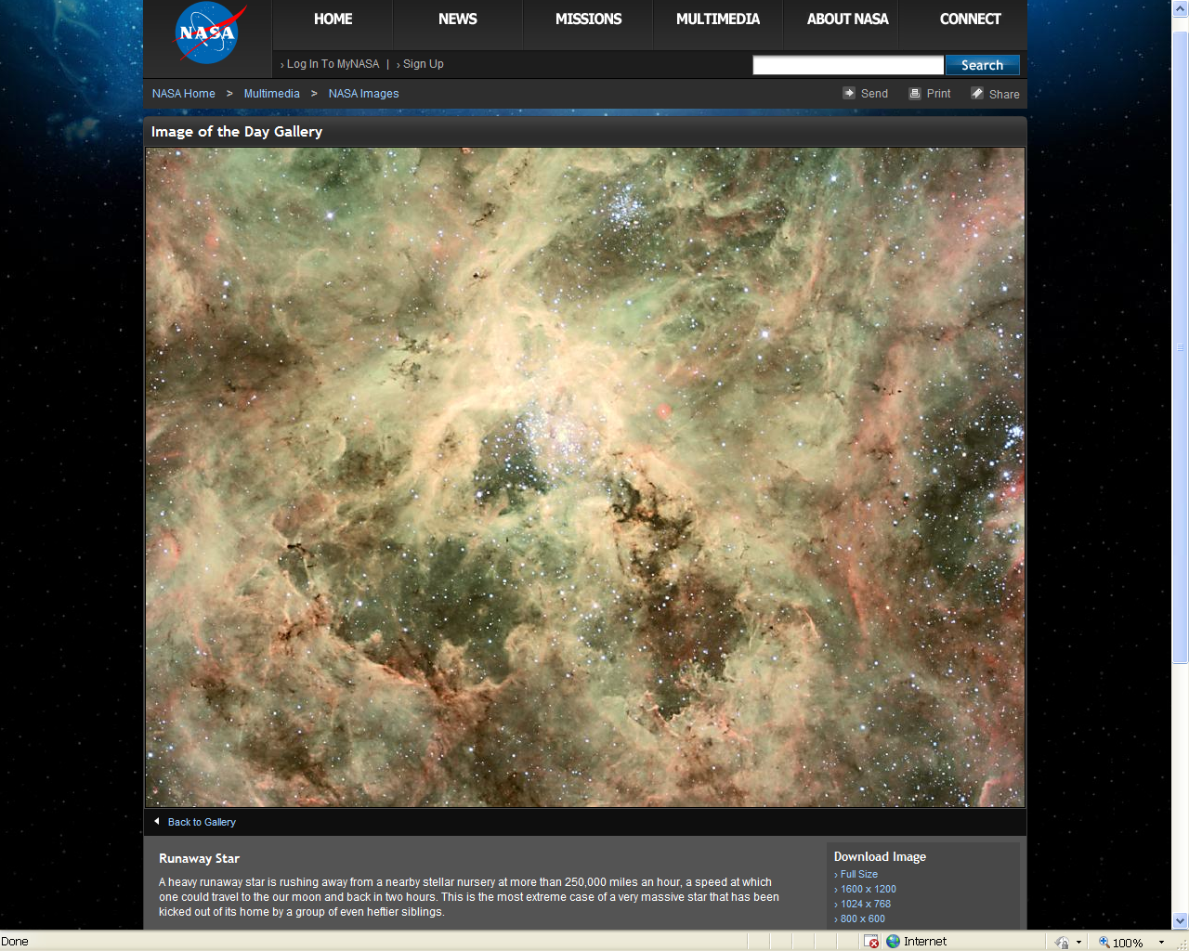
We live in an unstable Universe
NASA – massive runaway star 400,000 km per hour, earth to Moon in 1 hour

Slide 30
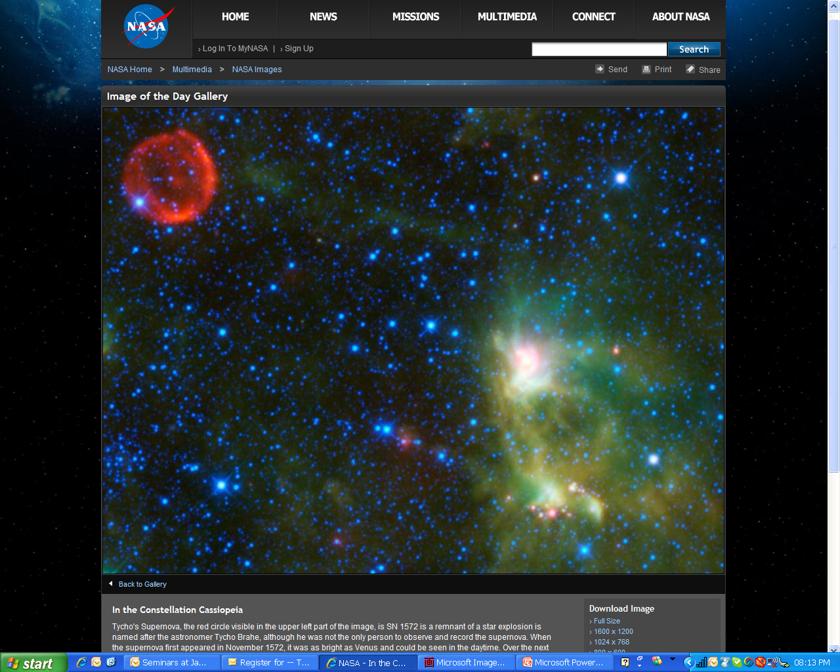
We live in an unstable Universe
NASA – Constellation Cassiopea
Supernova – massive explosion

Slide 31
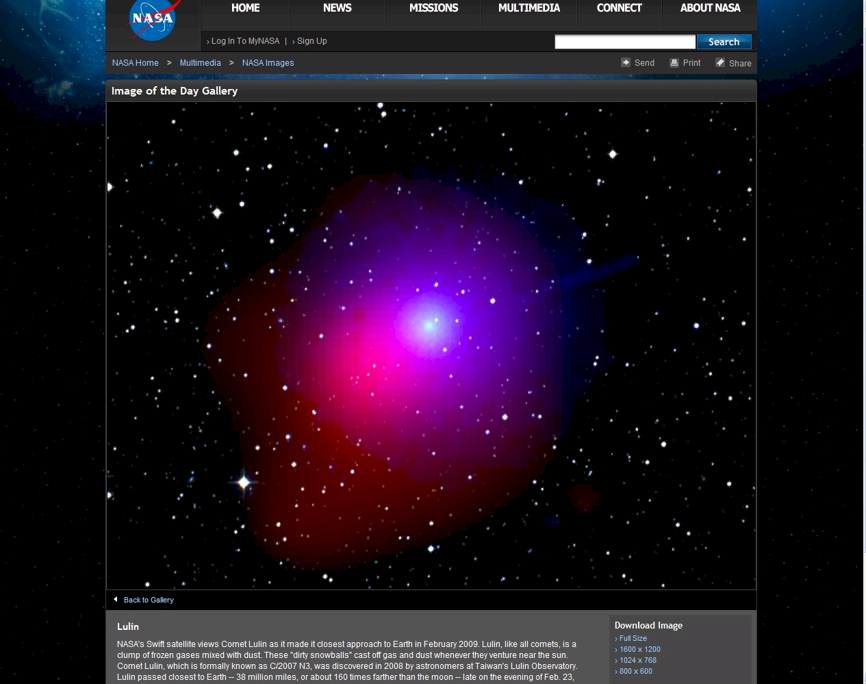
We live in an unstable Universe
NASA – Comet Lulin “dirty snowball” 160 times further than the moon (ie close!)

Slide 32
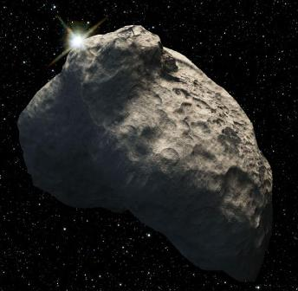
We live in an unstable Universe
NASA -- Kuiper Belt massive chunks of ice in space
“NASA's Hubble Space Telescope has discovered the smallest object ever seen in visible light in the Kuiper Belt, a vast ring of icy debris that is encircling the outer rim of the solar system just beyond Neptune.
“This artist's concept of the needle-in-a-haystack object found by Hubble is only 3,200 feet across and a whopping 4.2 billion miles away. The smallest Kuiper Belt Object (KBO) seen previously in reflected light is roughly 30 miles across, or 50 times larger.
“Hubble observations of nearby stars show that a number of them have Kuiper Belt-like disks of icy debris encircling them.”

Slide 33
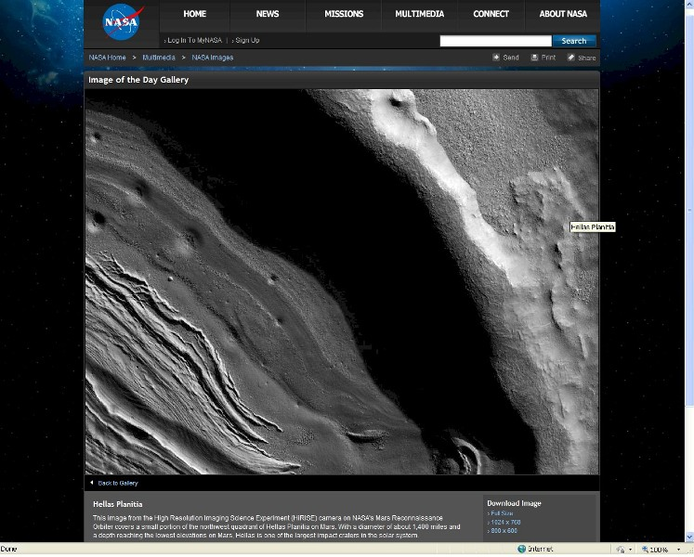
NASA -- Mars -- Hellas Planitia --
1,400 mile (2,250 km) diameter crater evidence of large space object impacts

Slide 34
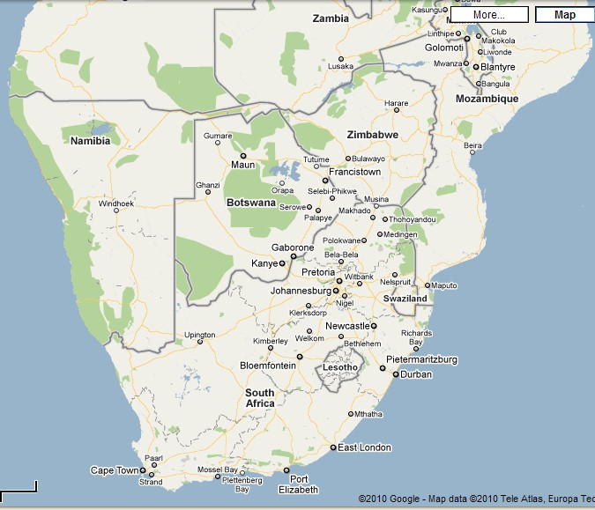
Hellas Planitia – 2,250 km diameter crater -- Cape Town, South Africa to Lusaka, Zambia

Slide 35
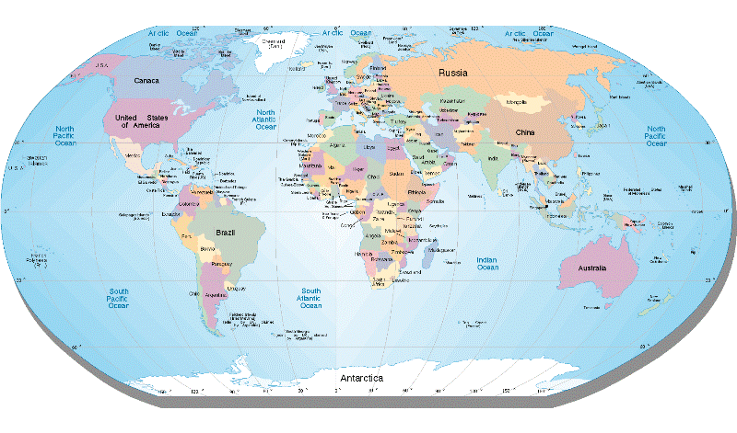
Hellas Planitia – what if something as big or bigger hit the earth?
Could such an impact give rise to significant surface disruption?

Slide 36
We live in an unstable Universe
Massive instability
Planets / chunks of rock travelling at 400,000 kilometers per hour
Massive chunks of ice 80 kilometers in diameter and larger – instant floods are potentially real
Massive sun spots
Impact craters 2,350 kilometers in diameter
Any assumption of steady state for millions of years is open to question

Slide 37
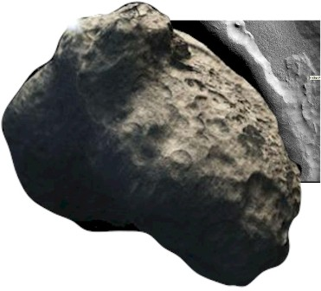
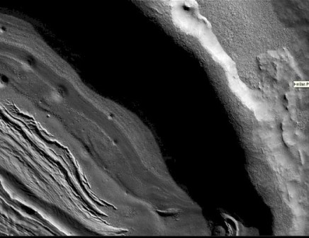
What if ... ?
A massive ice block hit the earth?
Notice the hole -- there is NOT a physical mass remaining
What if the crater was caused by an
ice object?
What if an ice object 2,250 km diameter
hit the earth and then melted?
4,47 thousand million cubic meters of water
Earth’s diameter = 12,700 km
Would cover earth’s surface to depth of 11,75 km
So a global flood could be caused by something much smaller!
2 km of water requires an object 1,250 km in diameter

Slide 38
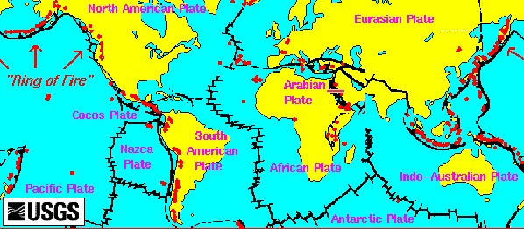
An unstable planet
500 active volcanoes today

Slide 39
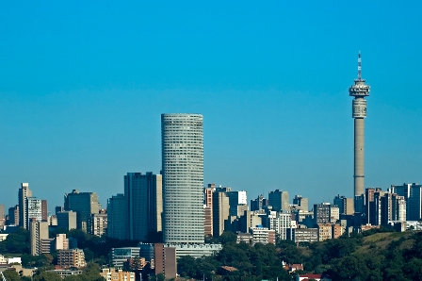
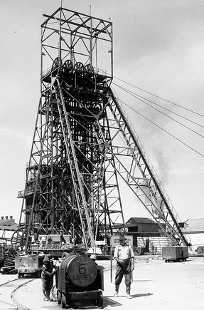
Johannesburg
My home town
Built on the gold of the
Witwatersrand (Afrikaans) =
“White Waters Ridge”
1,700 m above sea level
The source of the information on which this presentation builds its case – on first hand experience
Notes:
Where i have lived all my life, photo of Jo’burg skyline maybe from the website of high rise buildings
Mine dumps, headgears, one or two other photos that represent jhb to me and Northcliff – landmark visible from all over
Use the SABC tower, it is nice and clear

Slide 40

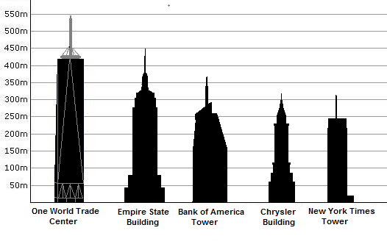
Hillbrow Tower
Johannesburg
269m -- height benchmark
One of the tallest buildings in Johannesburg
269 meters high
Used as a benchmark for height throughout this presentation
Notes:
Where i have lived all my life, photo of Jo’burg skyline maybe from the website of high rise buildings
Mine dumps, headgears, one or two other photos that represent jhb to me and Northcliff – landmark visible from all over
Use the SABC tower, it is nice and clear

Slide 41


Global height benchmarks
Empire state and
Burj Khalifa
Hillbrow Tower Johannesburg – 269 m
Empire State -- 450 m – 1.7 x Hillbrow
Burj Khalifa -- 828 m – 3.1 x Hillbrow
Relating the magnitude of the information presented in this discussion to man’s achievements
Notes:
Where i have lived all my life, photo of Jo’burg skyline maybe from the website of high rise buildings
Mine dumps, headgears, one or two other photos that represent jhb to me and Northcliff – landmark visible from all over
Use the SABC tower, it is nice and clear

Slide 42
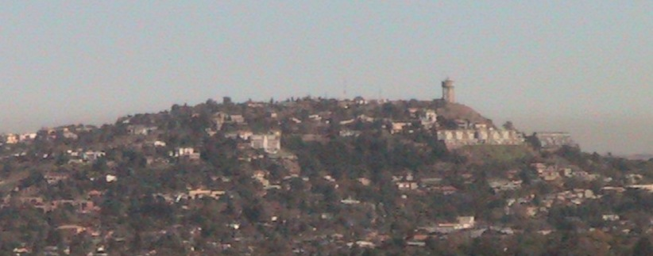
Northcliff
Major landmark from East, North and West of Johannesburg
Extension of the Gold Bearing metamorphic sedimentary rocks that form the gold reef
Within a few kilometres of where I live
The pivot point for this presentation – sums up the argument in one picture
Notes:
Introducing Northcliff
Landmark visible from many parts of Johannesburg, many of the main roads that radiate North, West and East follow a line of sight towards Northcliff for many kilometers – see if i have any images of this – have at least from Rosebank
It happens that in the context of this presentation Northcliff is also a geological and topographic landmark – this presentation will repeatedly refer back to Northcliff to tie things together, in fact the existence of Northcliff on its own evidences a major catastrophic hydraulic event of great magnitude – photo as used on first slide and logo, 30 degree slope photo close up and back of hill
30 degree south facing slope, extension of the Gold Mining horizons, amorphous quartzite, hard, glossy, evidence of intense heat and pressure, ceramic, cliff face, rocks plucked out, rough top, rocks plucked out, panorama, level horizon all the way round, view from top and default view massive cutting down from the top of the hill – in this presentation we will examine each of these attributes and see how they individually and collectively point to a massive global hydraulic flood event accompanied by massive tectonic upheaval
Domed over and same formations in the Magaliesberg about 50 km to the North but sloping north – check distance and also Roodepoort hills (name) sloping to the West, also at about 30 degrees
Images of all in progression
Define tectonic – quote and images?
Section from German drilling on website

Slide 43
Northcliff
Vitrified quartzite rocks (sand melted in a furnace)
Thirty degree south dipping slope continues mine formations
Continued 50 km north in the Magaliesberg
Underlain and up thrust by the Halfway House Granite Dome
1,807 m high point level with high points for hundreds of kilometers around, NO points higher in vicinity
Notes:
Introducing Northcliff
Landmark visible from many parts of Johannesburg, many of the main roads that radiate North, West and East follow a line of sight towards Northcliff for many kilometers – see if i have any images of this – have at least from Rosebank
It happens that in the context of this presentation Northcliff is also a geological and topographic landmark – this presentation will repeatedly refer back to Northcliff to tie things together, in fact the existence of Northcliff on its own evidences a major catastrophic hydraulic event of great magnitude – photo as used on first slide and logo, 30 degree slope photo close up and back of hill
30 degree south facing slope, extension of the Gold Mining horizons, amorphous quartzite, hard, glossy, evidence of intense heat and pressure, ceramic, cliff face, rocks plucked out, rough top, rocks plucked out, panorama, level horizon all the way round, view from top and default view massive cutting down from the top of the hill – in this presentation we will examine each of these attributes and see how they individually and collectively point to a massive global hydraulic flood event accompanied by massive tectonic upheaval
Domed over and same formations in the Magaliesberg about 50 km to the North but sloping north – check distance and also Roodepoort hills (name) sloping to the West, also at about 30 degrees
Images of all in progression
Define tectonic – quote and images?
Section from German drilling on website

Slide 44
Northcliff
Overlooks valleys cut down into the Granite with material deposited nearly a thousand kilometers away
Cliff face with massive boulders wrenched out
Top of hill rough free standing rocks
Graphic summary of this presentation
Notes:
Introducing Northcliff
Landmark visible from many parts of Johannesburg, many of the main roads that radiate North, West and East follow a line of sight towards Northcliff for many kilometers – see if i have any images of this – have at least from Rosebank
It happens that in the context of this presentation Northcliff is also a geological and topographic landmark – this presentation will repeatedly refer back to Northcliff to tie things together, in fact the existence of Northcliff on its own evidences a major catastrophic hydraulic event of great magnitude – photo as used on first slide and logo, 30 degree slope photo close up and back of hill
30 degree south facing slope, extension of the Gold Mining horizons, amorphous quartzite, hard, glossy, evidence of intense heat and pressure, ceramic, cliff face, rocks plucked out, rough top, rocks plucked out, panorama, level horizon all the way round, view from top and default view massive cutting down from the top of the hill – in this presentation we will examine each of these attributes and see how they individually and collectively point to a massive global hydraulic flood event accompanied by massive tectonic upheaval
Domed over and same formations in the Magaliesberg about 50 km to the North but sloping north – check distance and also Roodepoort hills (name) sloping to the West, also at about 30 degrees
Images of all in progression
Define tectonic – quote and images?
Section from German drilling on website

Slide 45
Be critical
Take time to digest what I present
What follows is highly controversial
Turns widely held theories on their head
Requires a major rethink if you accept what is presented
Do NOT take snap decisions for or against
Weigh up the evidence and make a considered decision
Look around as you travel and see whether what is proposed here explains the topography and geology elsewhere in the world
I am confident that the interpretation postulated here is valid, valuable and an accurate interpretation of key elements of terrain formation and, by extension, history
Notes:
What is presented here is controversial, it is contrary to widely and commonly held theories, it requires a major rethink on many issues, not least of which being where did you and I come from
I urge you NOT to take snap decisions
IF you think critidcally about this you weill realize that it is NOT waco as some have stated
Give it time, look around you as you travel around, I expect that you will find other mountains, hills, valleys, etc that will provide independent confirmation, you may even find, as I have done, that the world around takes on a whole new life and level of interest as I visualize the events that gave rise to the formation of mountains, hills, valleys, etc as I travel

Slide 46
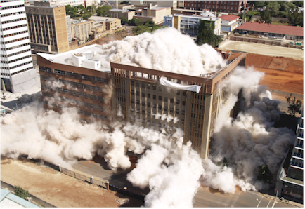




Catastrophic and dramatic change is fast NOT gradual

Slide 47
Summing up
Whatever theory you adopt must be absolutely reliable and withstand all reasonable criticism
It must be practical
It must be possible to validate it against any situation that you can personally identify
You should NOT abdicate you intellect in order to adopt it
“I can name a hundred / thousand eminent ... (geologists / archaeologists / zoologists /... etc) who will disagree with you” is NOT a valid argument against what is presented here
This is “waco” is NOT a valid argument against what is presented here – do NOT allow yourself to be intimidated
Notes:
Theories must be bullet proof
What follows is based on an intense engineering and practical analysis of the real world
It must make sense to you
You should be able to validate much of what I say within the parameters of your own life experience and where you live
Dramatic change happens rapidly
There are serious laws of physics and engineering which govern how land forms can be shaped and formed

Slide 48
Coming next
The geology of South African Gold Mines
Layered sedimentary metamorphosed rock all around the world
The Halfway House Granite Dome and other domes – massive intrusion
The African Erosion Surface – massive uniform cutting action
Incised valley’s – massive erosive forces
When did all this happen? – Really?
Why are we here? Signs of judgment?
Where did the water come from? And where did it go? – think outside the box
Summing up, comprehensive evidence of a global flood
End note – some other important information – Where will YOU spend eternity
Notes:
List of other sections

Slide 49

Ensure that your theory of topograhic formation is like a bridge and will stand up and NOT fall down

Slide 50
Turning history on its head
Massive evidence of a global flood
What does it all mean?
Continued in part 2
Gold Mines in South Africa
Contact me James@ETI-Ministries.org Website www.ETI-Ministries.org

